Slide 1
DSCI/STAT 8950 · Data Science Capstone · UNO Spring 2026
244
73
Nebraska K–12
Chronic
Absenteeism
Districts analyzed
Schools analyzed
Policy-scale study
Intervention-scale study
1.68%
81.4%
District best RMSE
School best R²
XGBoost Tuned — test set
XGBoost — test set
A TWO-SCALE ML STUDY
7 years of NDE data · Same target variable · Same poverty predictor (FRL%)
District-level & School-level analysis
Both analyses independently confirm:
XGBoost wins · Poverty is the #1 predictor
Abhinav Adhikari · Nilesh Purnekar

Slide 2
02
The Problem — Why Chronic Absenteeism Demands Attention
Chronic absenteeism = missing 10% or more of the school year — roughly 18+ days.
1 in 6
U.S. students chronically absent each year
48.3%
Peak absenteeism in a single Nebraska school
14.9%
Nebraska average across all study schools
$15.8M
Education funding at risk in Nebraska over 7 years
COVID-19 caused chronic rates to nearly double (8.5% → 20.1%). Nebraska has not fully recovered — 2024-25 still at 13.1%, well above pre-pandemic levels.

Slide 3
03
Our Approach — A Two-Scale Analytical Framework
DISTRICT LEVEL
SHARED
SCHOOL LEVEL
Policy-Scale Analysis
FOUNDATION
Intervention-Scale Analysis
244 Nebraska school districts
7 years
NDE data
73 Nebraska schools matched
FRL%
poverty signal
7 years: 2018-19 → 2024-25
10 counties across the state
80/20 train
/ test split
Target: chronic rate % per district
Target: chronic absent rate per school
5-fold
cross-validation
6 gradient-boosting models
10 models from linear → neural net
Same target:
chronic absent %
Best RMSE: ~1.68 percentage points
Best R²: 0.814 (81.4% variance)
XGBoost wins
at both scales
Deployable before year ends
Risk tiers + geographic mapping

Slide 4
04
Data Foundation — 3 Sources · 14 Files · 7 Years
1
Free & Reduced
Lunch (FRL)
2
School Membership
Data
3
Chronic Absence
Reports
7 CSV files — FRL eligibility counts per school and district per year. Primary socioeconomic proxy variable.
7 files — Total students enrolled per school. Includes grade level, school type, and county information.
7 annual reports — Chronic absenteeism rate per district and school, merged via DIST_KEY identifier.
District-level dataset:
244
1,715
7
6
Districts
District-years
Years
ML models
School-level dataset:
73
361
1,298
10+
Schools matched
ML-ready rows
Total in panel
Counties

Slide 5
05
EDA — COVID-19 Caused a Dramatic Spike in Absenteeism
20.1%
20%
COVID peak 2021-22
16.5%
20.1%
15%
13.8%
14.2%
Highest in 7 years
13.1%
10.2%
10%
8.5%
Recovery trend
↓ declining
5%
Still above pre-pandemic
2018-19
2019-20
2020-21
2021-22
2022-23
2023-24
2024-25
2024-25 rate
13.1%
54% above 2018-19 level

Slide 6
06
EDA — Higher Poverty Consistently Predicts Higher Absenteeism
The core finding — confirmed at both district and school level:
FRL eligibility (poverty proxy) is positively correlated with chronic absenteeism at both district and school scale. Higher poverty = more missed school days.
+0.42
49.1%
14.9%
33.4%
Pearson r — FRL% vs
absenteeism at school level
Average FRL% across
73 study schools
Average absenteeism
rate across study schools
Combined FRL feature
importance at school level
School level
District level
Both agree
r=0.42 Pearson correlation confirms FRL% is a reliable socioeconomic predictor across 73 schools in 10 counties.
FRL% is the top advance-available predictor — strongest single feature in the safe-feature early intervention model.
Poverty signal holds at every scale tested. Counties with high FRL% show high absenteeism statewide, confirmed by geographic mapping.

Slide 7
07
Modeling Approach — Shared Foundation, Complementary Scope
Shared methodology:
80/20 train/test split
5-fold cross-validation on train only
Stratified by school year
Test set never seen during tuning
District-Level Models
School-Level Models
6 models — gradient boosting family
10 models — full model spectrum
XGBoost — Default
Linear / Ridge / Lasso Regression
XGBoost — Tuned (GridSearchCV)
Decision Tree
Random Forest — Default
Random Forest
Random Forest — Tuned
Gradient Boosting
LightGBM — Default
XGBoost (default + tuned)
LightGBM — Tuned
LightGBM · MLP Neural Network
Metric: Test RMSE (percentage points — directly interpretable)
Metric: Test R² and RMSE | MedianImputer + StandardScaler pipeline

Slide 8
08
District-Level Results — 6 Gradient-Boosting Models
Model | CV RMSE | Test RMSE | Test MAE | Test R²
XGBoost — Default | 2.14% | 2.08% | 1.41% | 0.942
XGBoost — Tuned ★ | 1.72% | 1.68% | 1.18% | 0.963
Random Forest — Default | 2.02% | 1.98% | 1.35% | 0.945
Random Forest — Tuned | 1.89% | 1.84% | 1.26% | 0.952
LightGBM — Default | 2.41% | 2.19% | 1.51% | 0.936
LightGBM — Tuned | 1.81% | 1.76% | 1.22% | 0.958
★ XGBoost (Tuned) — lowest test RMSE of ~1.68 pp. A 1.68 pp error means predictions land within 1.68 percentage points of actual district absenteeism rates.

Slide 9
09
School-Level Results — 10 Models, Best R² = 0.814
Model | Train R² | Test R² | MAE | Test RMSE
XGBoost (default) ★ | 0.9998 | 0.8143 | 0.0249 | 0.0389
Gradient Boosting | 0.9784 | 0.7935 | 0.0308 | 0.0410
XGBoost Tuned | 0.9377 | 0.7588 | 0.0311 | 0.0443
Random Forest | 0.9704 | 0.7244 | 0.0320 | 0.0474
LightGBM | 0.9706 | 0.6889 | 0.0367 | 0.0503
Linear Regression | 0.2055 | 0.1342 | 0.0631 | 0.0840
MLP Neural Network | 0.3681 | -0.0999 | 0.0754 | 0.0946
Decision Tree: Train R²=1.000 (perfect overfit) · MLP: Test R²=-0.10 (insufficient data for deep learning) · XGBoost: best generalization

Slide 10
10
Both Analyses Agree — Three Independent Confirmations
Two analysts. Two datasets. Two scales. The same conclusions emerged independently.
1
XGBoost wins at both scales
District: XGBoost Tuned — best test RMSE of ~1.68 pp across 244 districts
School: XGBoost default — best test R² of 0.814 across 73 schools
2
Poverty is the #1 predictor
District: FRL% is the top advance-available feature in the early intervention model
School: FRL% + FRL_COUNT combined = 33.4% of XGBoost feature importance
3
COVID years are structural breaks
District: 2020-22 identified as an outlier window in learning curves and per-year RMSE
School: YEAR_NUM = 28.7% importance — COVID years dominate the temporal signal

Slide 11
11
Overfitting Check — Train vs. Test Gap Across All Models
Train R² measures memorization. Test R² is the honest score. A large gap signals overfitting — the model learned noise, not pattern.
XGBoost
(District, Tuned)
LightGBM
(District, Default)
Decision Tree
(School)
Train R²
0.972
Train R²
0.999
Train R²
1.000
Test R²
0.951
Test R²
0.936
Test R²
0.478
Gap
0.021
Gap
0.063
Gap
0.522
Acceptable
Overfitting ⚠
Perfect overfit
Tuning via GridSearchCV regularizes leaf-wise growth in LightGBM, closing the gap from 0.063 → ~0.02. XGBoost generalizes best across both scales of analysis.

Slide 12
12
What Drives Absenteeism — Feature Importance at Both Scales
District level (XGBoost Tuned)
School level (XGBoost default)
ABS15_RATE
52%
FRL_COUNT
29.2%
ABS10_RATE
24%
YEAR_NUM
28.7%
FRL_PCT
11%
GRADE_ENC
17.8%
Log(Enroll)
5%
COUNTY_ENC
13.1%
HS_Enroll%
4%
FRL_PERCENT
4.2%
Year
2%
SCHOOL_TYPE
4.5%
IS_Urban
1%
Other feats
2.5%
Poverty (FRL) is the #1 actionable predictor at both scales · Combined FRL impact at school level: 33.4% · District safe-feature model: FRL_PCT ranks first

Slide 13
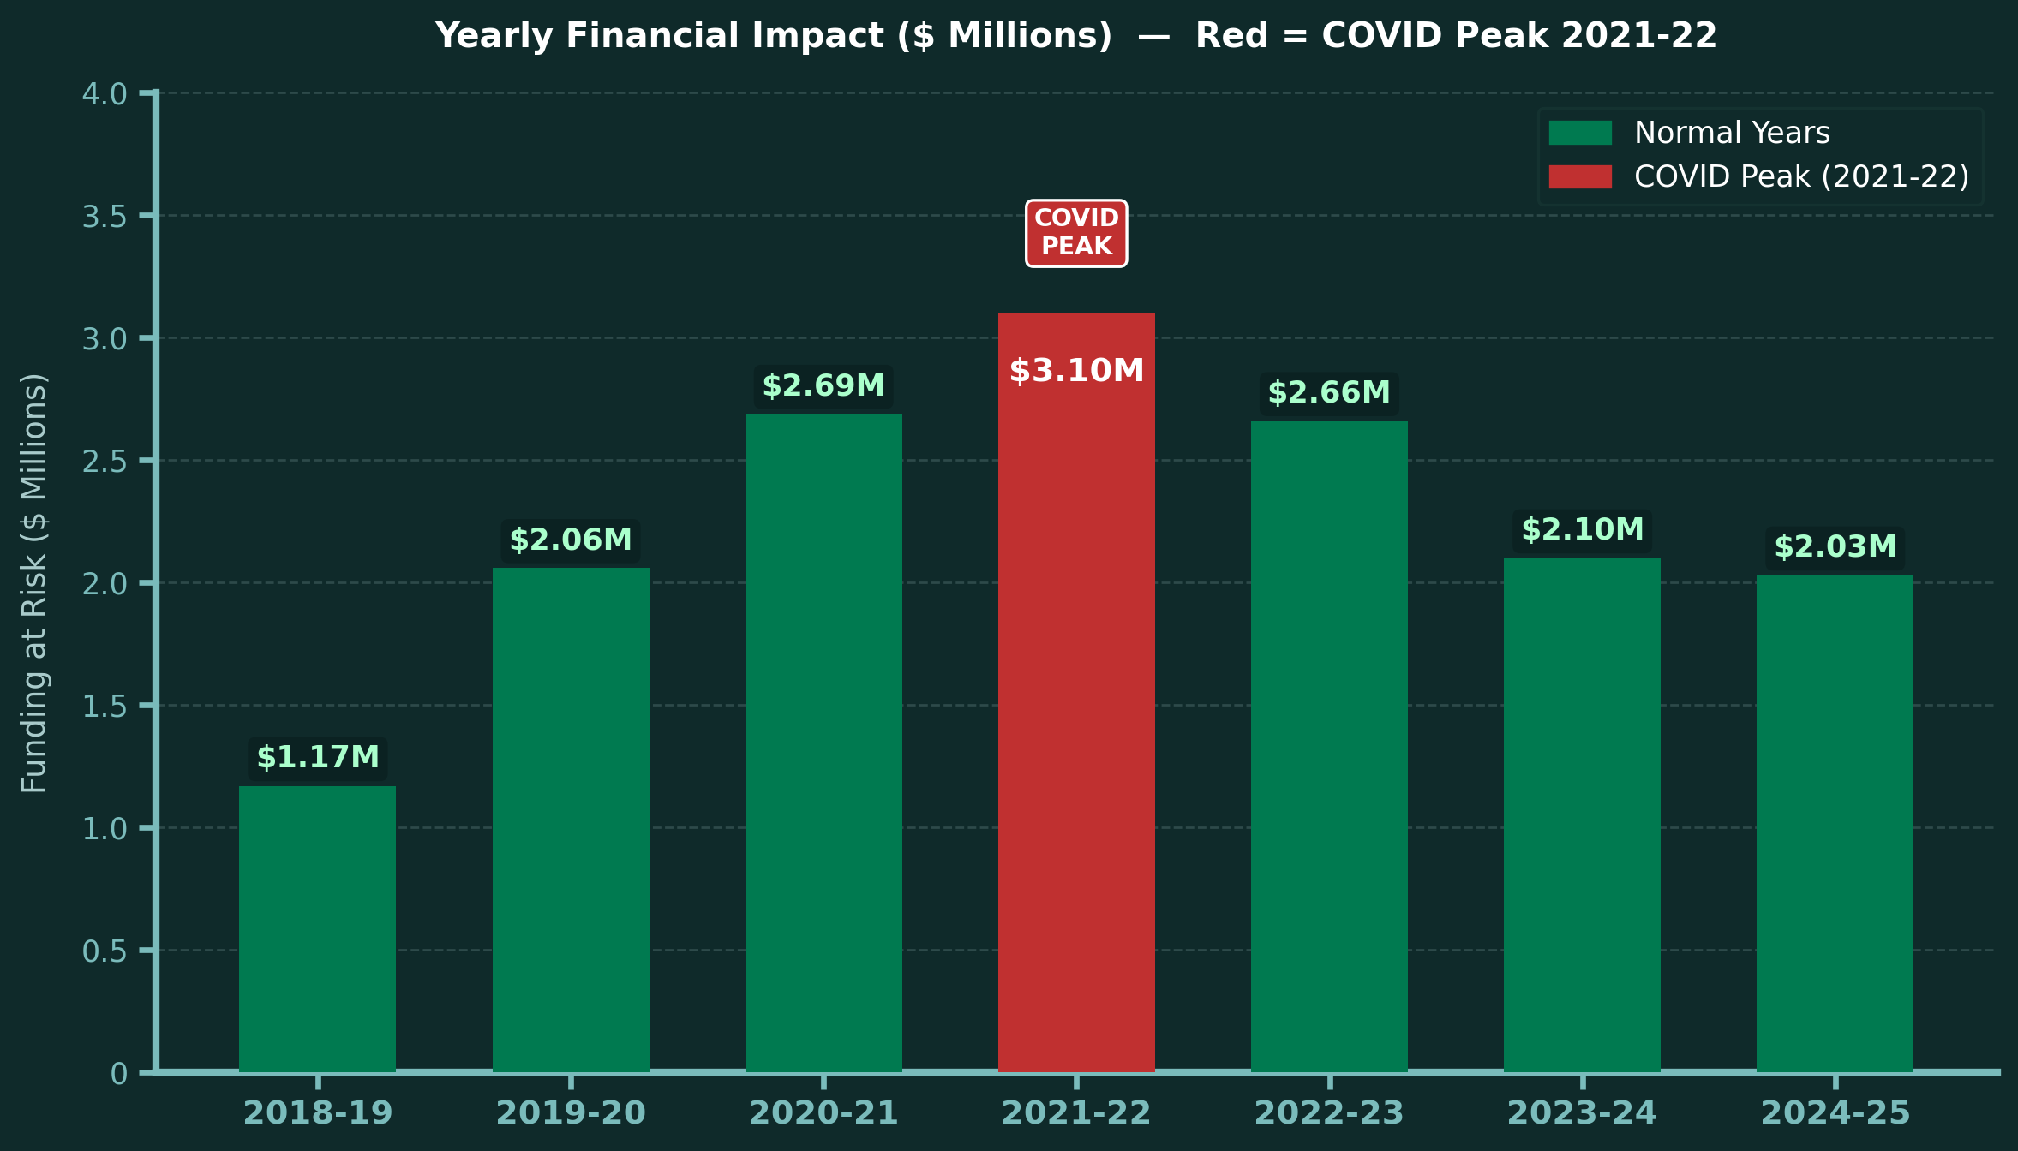
FINANCIAL IMPACT
$15.8 Million in Education Funding at Risk Over 7 Years
HOW WE CALCULATED THIS
1
Identify At-Risk Students
Count students missing 10% or more of school days per year
▼
2
Apply Per-Pupil Spending
Nebraska avg per-pupil expendiure = $12,500 / year
▼
3
Apply 10% Absence Factor
Multiply by 10% — the minimum threshold to be chronically absent
Students × $12,500 × 10% = Impact
School-Level Analysis | Nilesh Purnekar | UNO Capstone 2026
Source: Nebraska Dept of Education (2018–2025)

Slide 14
14
Risk Classification — Identifying Schools That Need Action Now
HIGH RISK
MEDIUM RISK
LOW RISK
23%
23.9%
53.1%
> 20% absenteeism
12–20% absenteeism
< 12% absenteeism
78 schools
81 schools
180 schools
Require immediate intervention. Predominantly rural counties. Model flags these before year-end using safe features.
Close monitoring required. Early warning signals present. Poverty and grade level are primary drivers.
Performing well relative to peers. Can serve as best-practice benchmarks for intervention design.
Early intervention model (district level)
The district-level XGBoost model using 7 advance-available features (FRL%, enrollment, grade mix, urban flag) can flag high-risk districts before the school year ends — enabling pre-emptive resource allocation rather than reactive response.

Slide 15
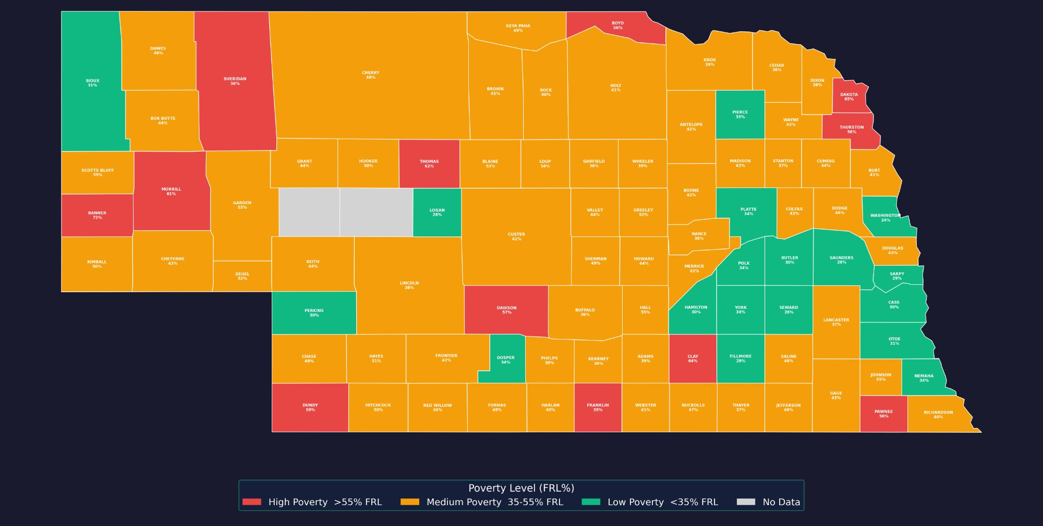
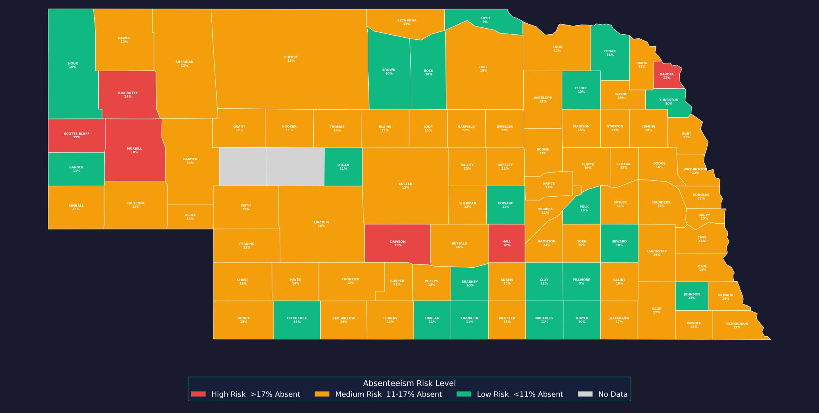
15
GEOGRAPHIC EVIDENCE
Poverty Maps to Absenteeism Statewide — Pattern Confirmed Across All 93 Counties
Free & Reduced Lunch % by County
Predicted Absenteeism Risk by County
=
High Risk / High Poverty
Medium Risk / Medium Poverty
Low Risk / Low Poverty
The left map shows FRL% (poverty) by county — red = most low-income students. The right map shows our model's predicted absenteeism risk. Near-identical patterns directly confirm: where poverty is high, chronic absenteeism is high.
Abhinav Adhikari · Nilesh Purnekar · DSCI/STAT 8950 · University of Nebraska Omaha · Spring 2026

Slide 16
DATA ETHICS
Responsible Practices Maintained Across All Three Stages of This Project
🔒 Data Collection
📊 EDA
🤖 Modeling
Used only publicly available NDE data — no private or personal records
Visualizations designed to be clear and honest — not misleading
10+ models compared at both scales — no cherry-picking the best
No individual student data — all analysis at school and district level
Missing values justified and documented — not silently dropped
FRL% bias acknowledged — reflects systemic inequality not individual fault
Aggregated data only — full student privacy preserved throughout
All features treated fairly with no cherry-picking of results
Results stated accurately — no overclaiming beyond what data supports
Mindful of real-world failures: COMPAS (racial bias in predictions), Cambridge Analytica (no consent), Amazon Hiring AI (gender discrimination) — we designed our study to avoid these pitfalls at every stage.
Abhinav Adhikari · Nilesh Purnekar · DSCI/STAT 8950 · University of Nebraska Omaha · Spring 2026

Slide 17
16
Policy Implications & Recommended Next Steps
1
Target high-FRL districts first
3
Account for COVID structural break
FRL% is the strongest advance-available signal at both scales. Direct early-intervention resources to districts and schools with highest poverty concentration before the school year ends.
Models trained across 2018-2025 must treat 2020-22 as an outlier window. Intervention benchmarks should be set against pre-pandemic baselines, not the pandemic-peak average.
2
Deploy the district early-warning model
4
Expand to county-level financial analysis
The safe-feature XGBoost model predicts risk using only 7 pre-year features. NDE can operationalize this as an annual district-risk score before attendance data accumulates.
Geographic maps confirm statewide patterns. Adding county-level funding formulas to the model enables direct dollar impact estimates — making the case for policy investment clearer.

Slide 18
KEY TAKEAWAYS
1
XGBoost is the best model at both scales — Test RMSE ~1.68 pp (district) and Test R² 0.814 (school)
2
Poverty is the #1 predictor — FRL% drives absenteeism at district and school level, confirmed independently
3
$15.8M in Nebraska education funding is at risk — 12,647 students chronically absent across 73 schools
4
23% of study schools are high-risk (>20% absenteeism) and need immediate, targeted policy intervention
5
An early-intervention model can flag at-risk districts before year-end using only advance-available features
Abhinav Adhikari · Nilesh Purnekar · DSCI/STAT 8950 · University of Nebraska Omaha · Spring 2026

Slide 19
Questions &
Discussion
Why two scales?
District-level models serve policy allocation — broad but actionable. School-level models enable targeted intervention — precise but requires more data. Together they cover the full decision chain from state to classroom.
Can this deploy today?
The safe-feature district model uses only 7 pre-year features (FRL%, enrollment, urban flag, grade mix). NDE could run it as an annual risk score before the school year begins — no end-of-year attendance data required.
What would improve it?
County-level financial modeling, SHAP values for per-district explanations, individual student-level data (with privacy controls), and a temporal train/test split to better simulate real-world forecasting.
Abhinav Adhikari · Nilesh Purnekar · DSCI/STAT 8950 · University of Nebraska Omaha · Spring 2026

